Slide 1
UltraContacts.com
Group 22
Summer 2020
UCF

Slide 2
The Team
Database: David Velez
UI: Daniel Biller & Gaspar Dantas
API: Mirette Marzouk & Jack Roberts
Project Manager: Cade Gutscher

Slide 3
Technology Used

Slide 4





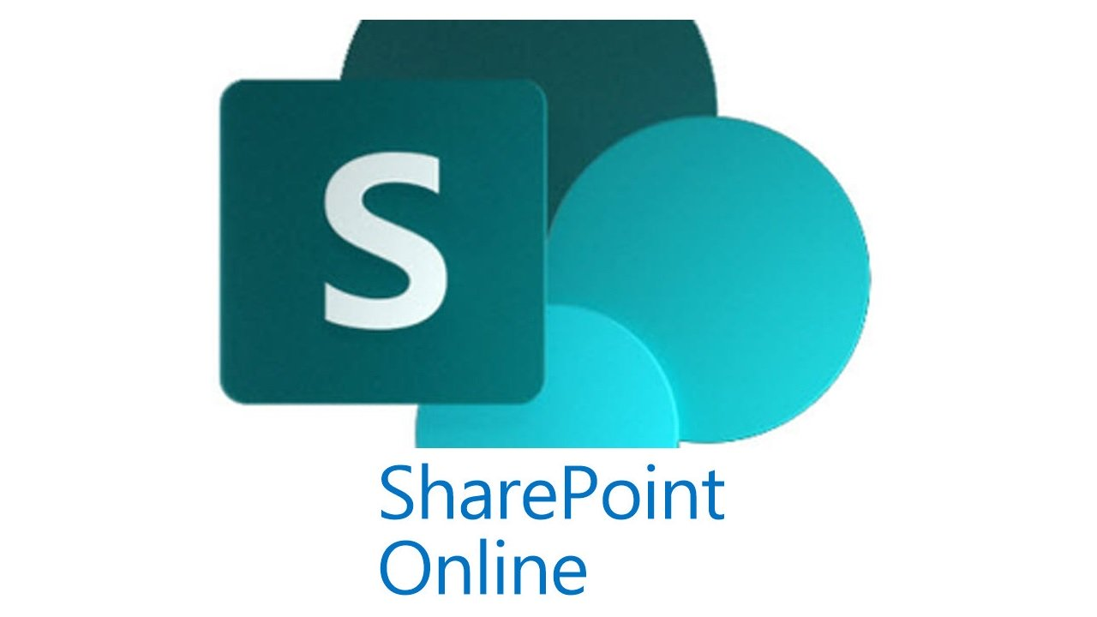



Slide 5
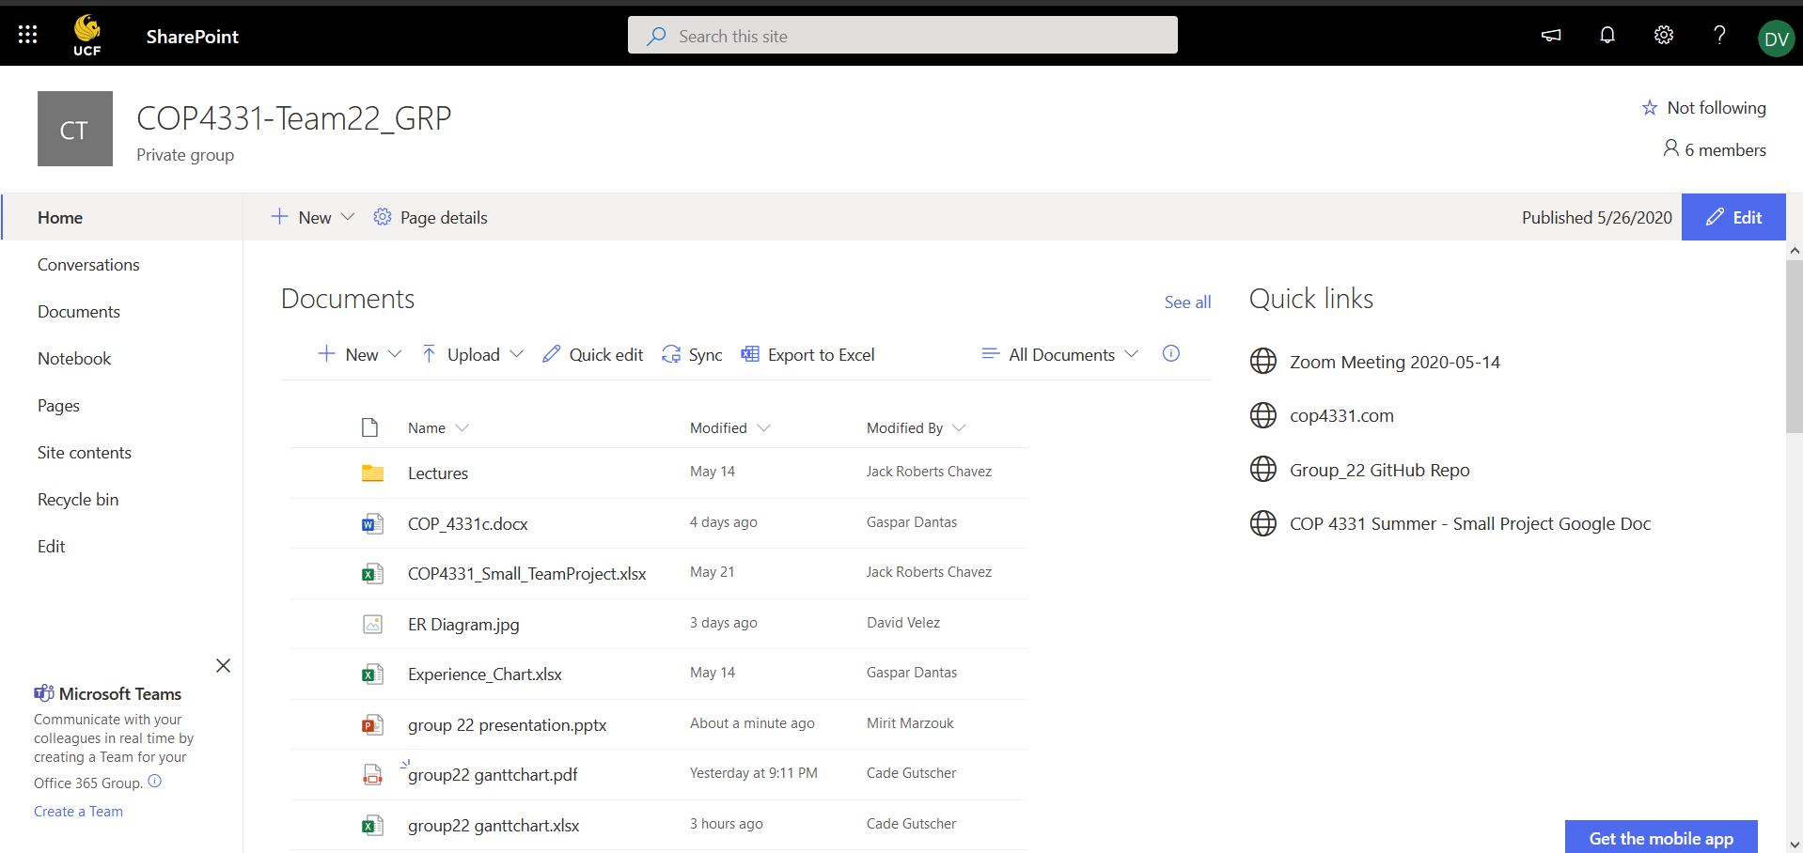
SharePoint

Slide 6
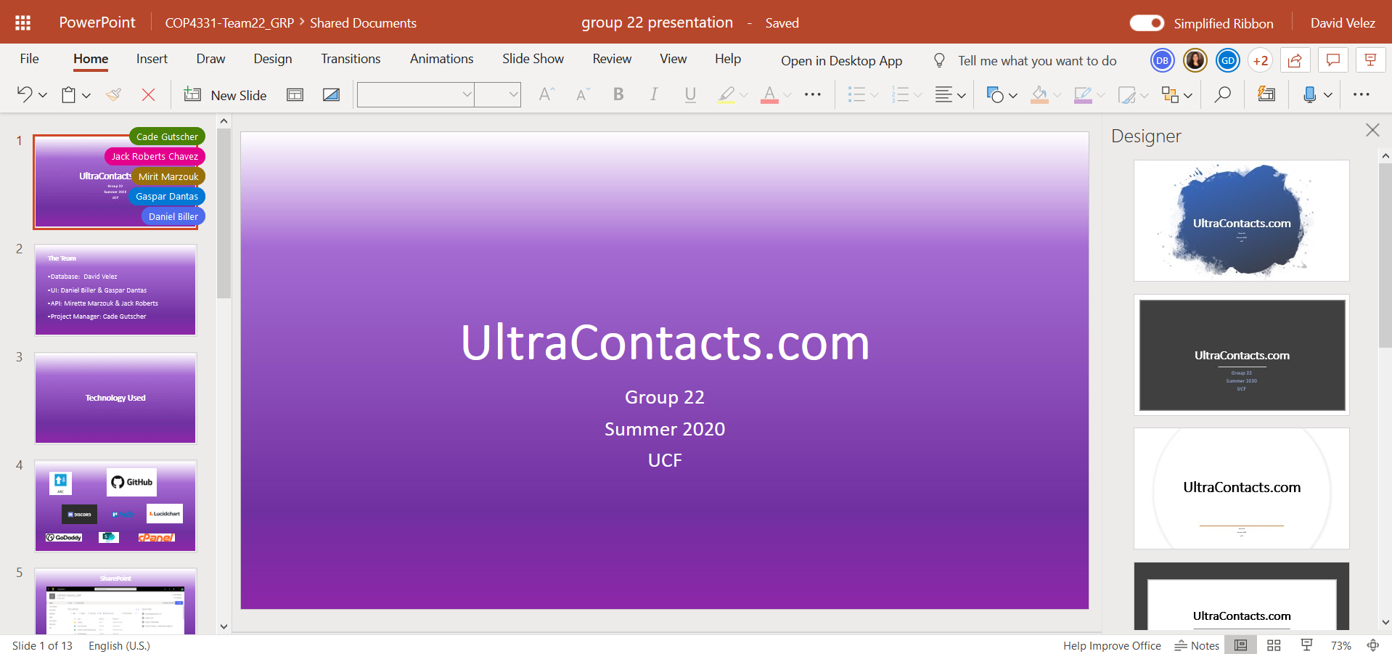
SharePoint

Slide 7
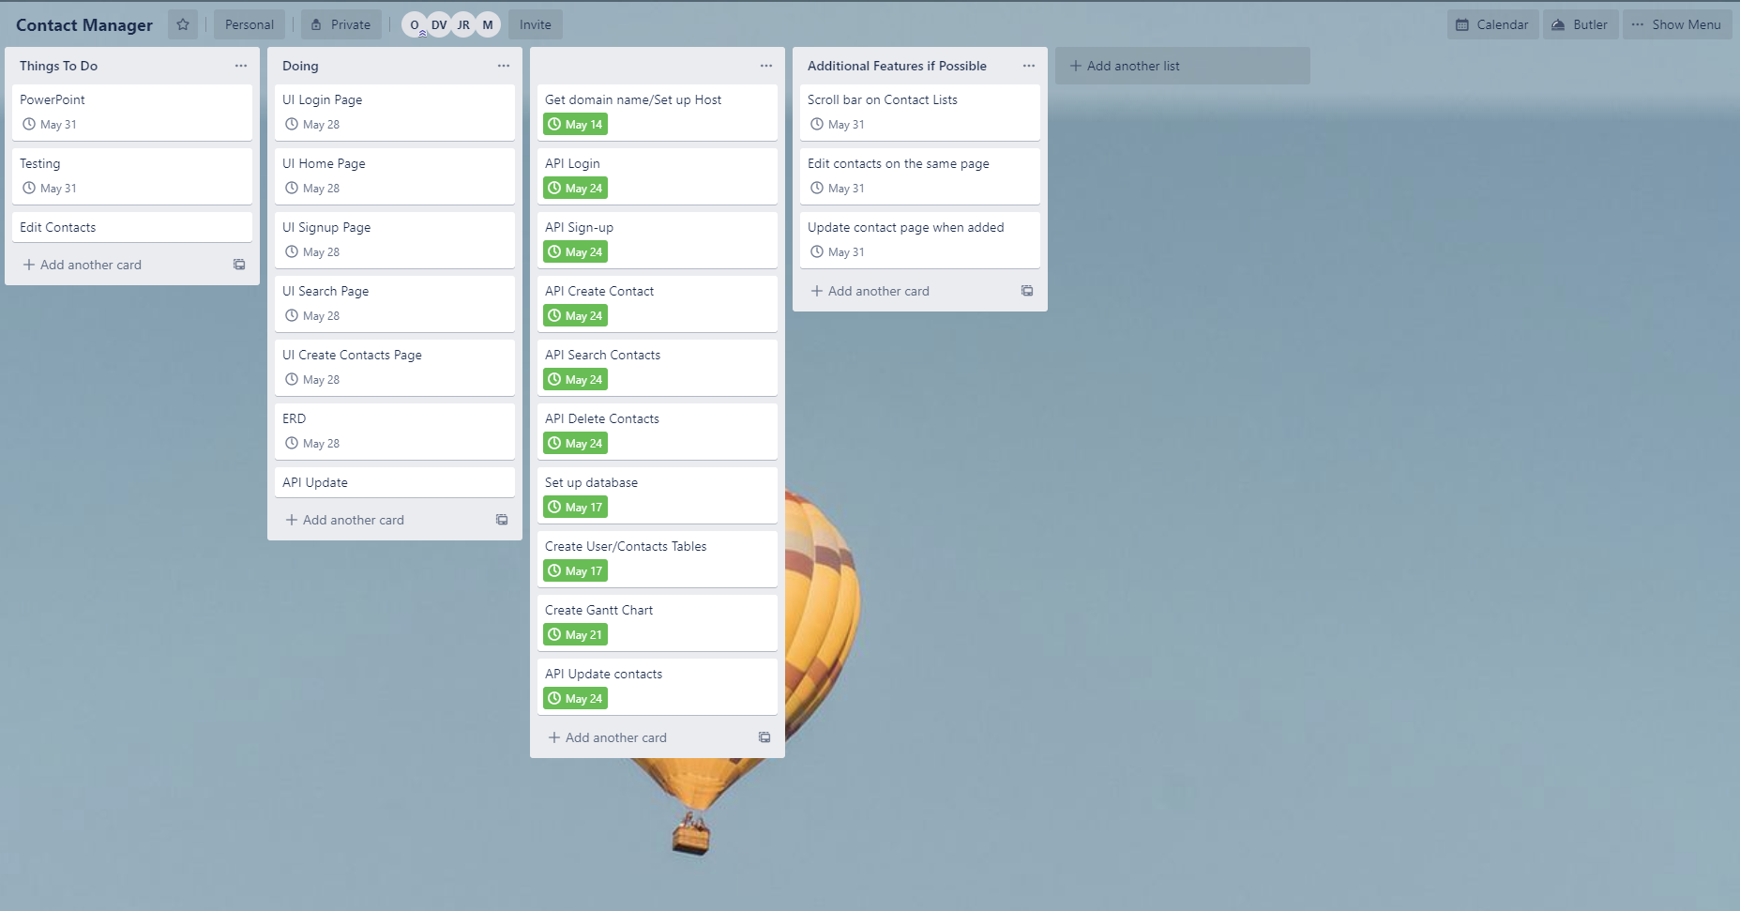
Trello

Slide 8
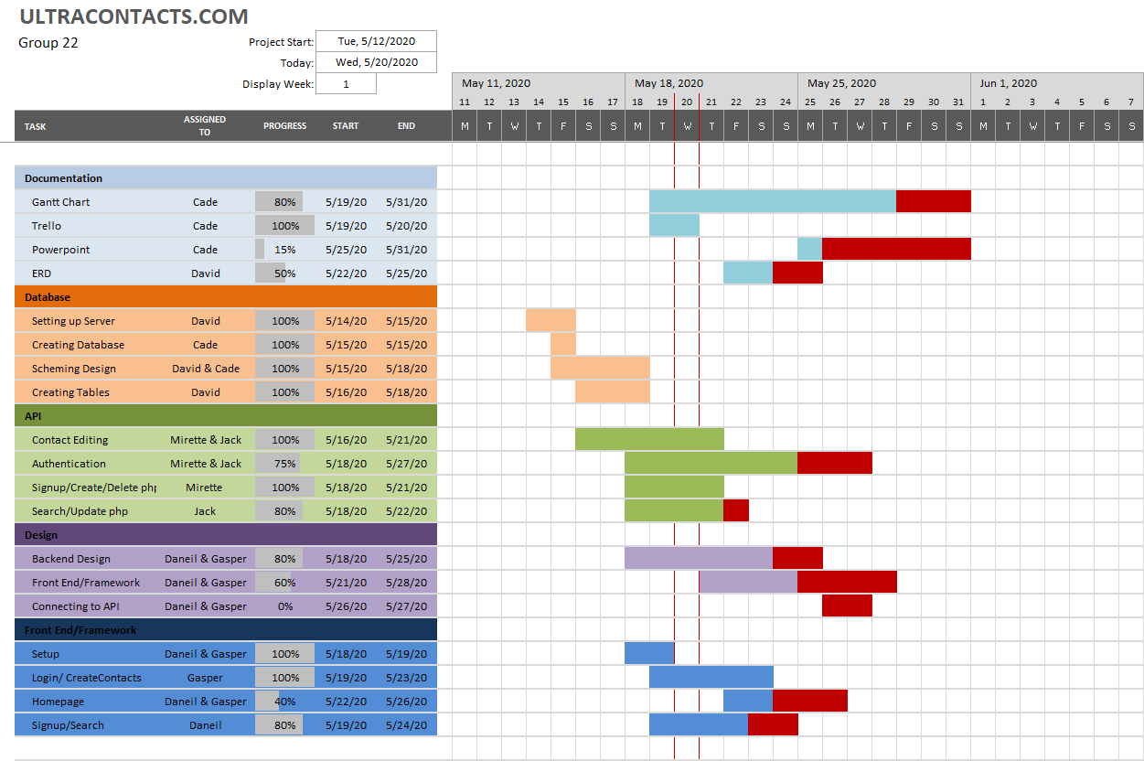
Gantt Chart During Development

Slide 9
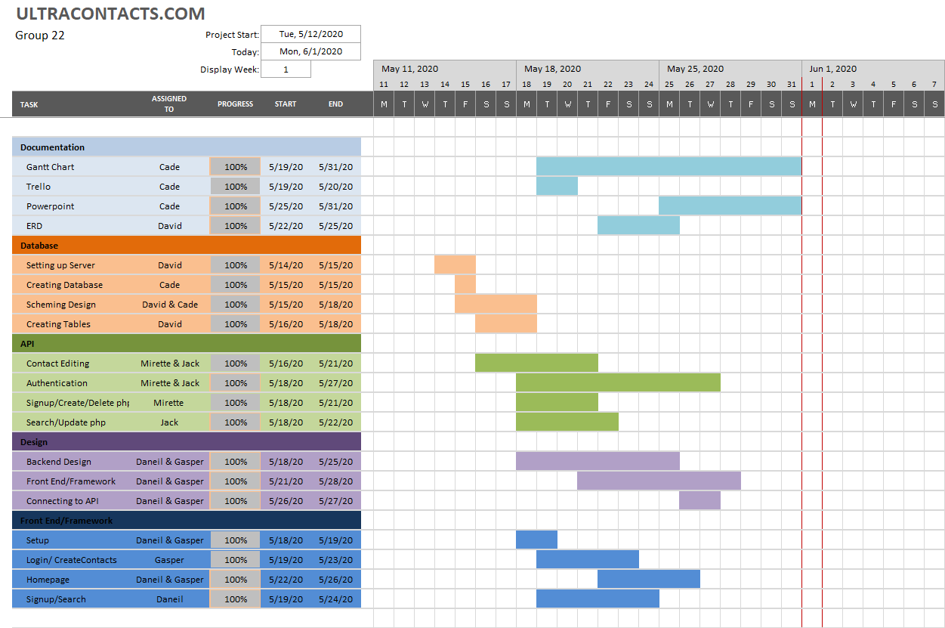
Gantt Chart Finished

Slide 10
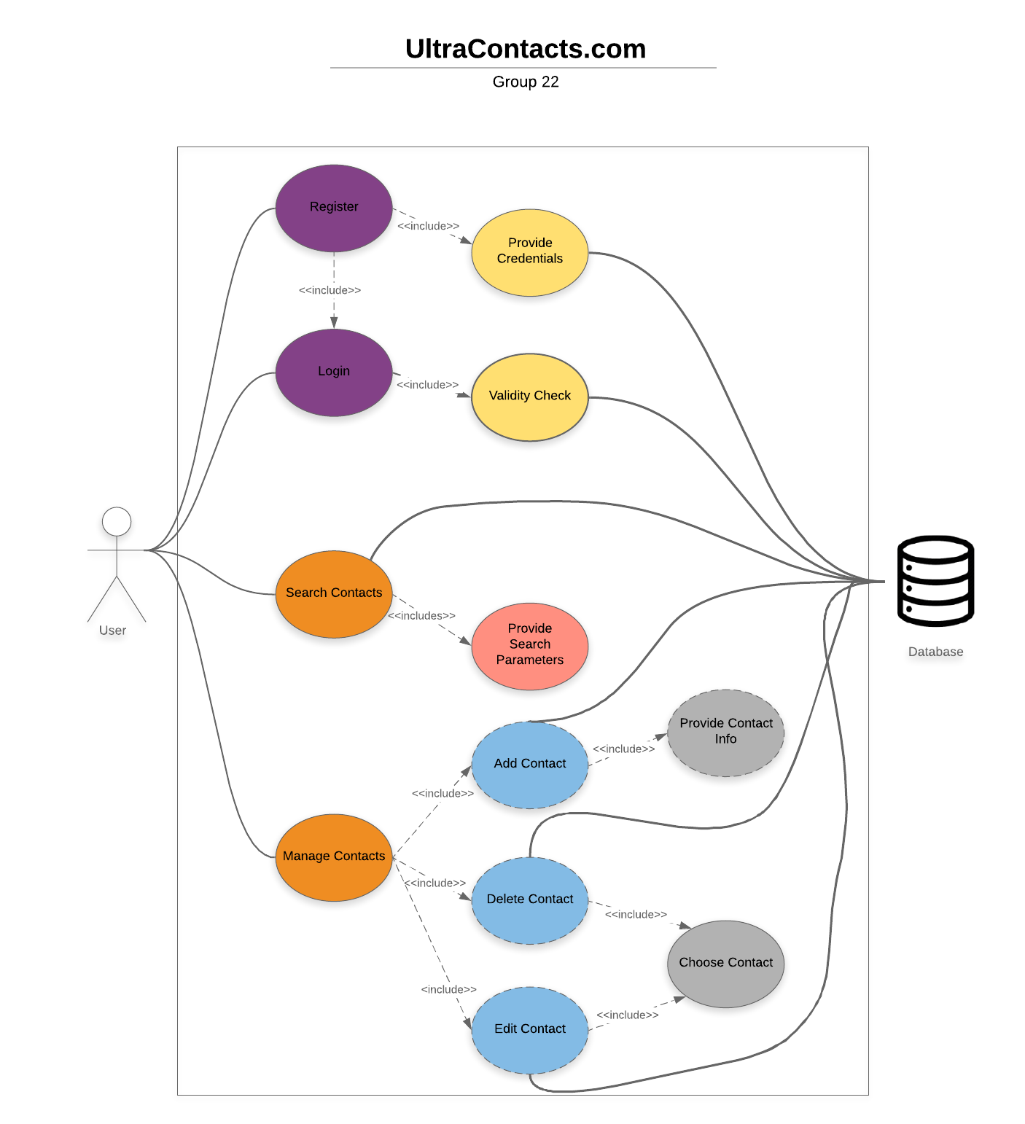
Use Case Diagram

Slide 11
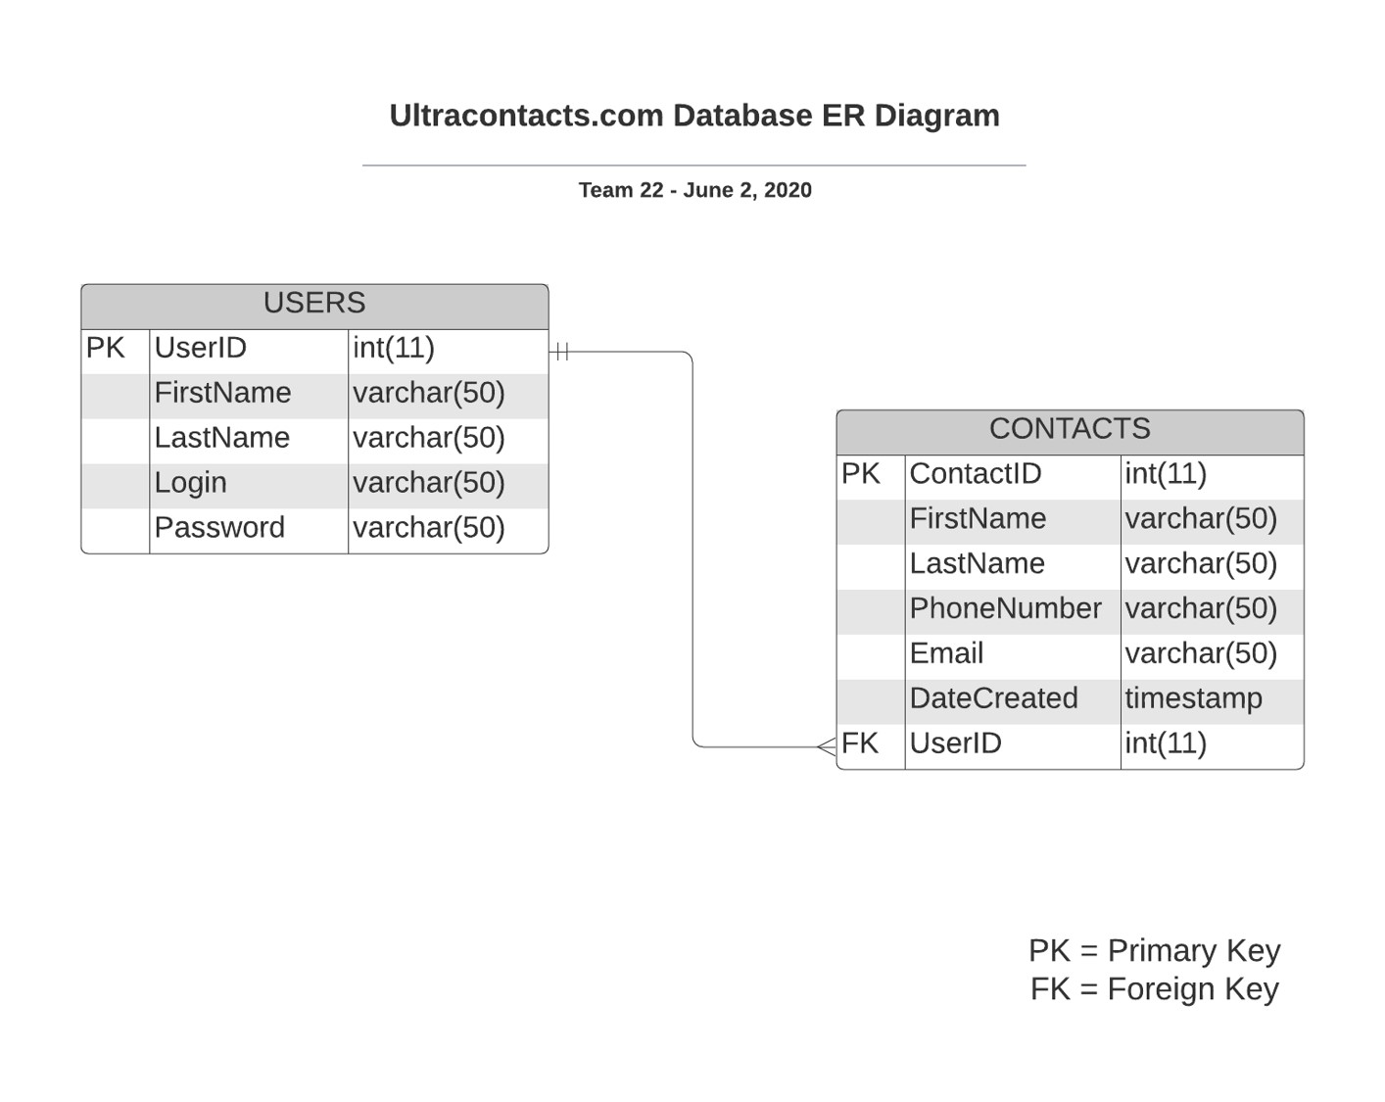
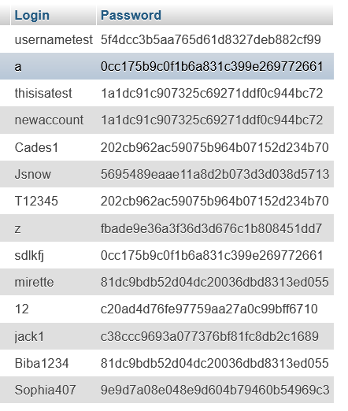
ERD

Slide 12
 | Things that went well | Things that didn’t go well
Database | -MyPHPAdmin within cPanel made it easy to create database | -Original Database design was not on the same page as the API
API | -Ahead of schedule | -The Search API caused issues
UI | -All agreed on similar style/design based on example websites provided | -Connecting to API -Passing variables across HTML
Misc. | -Fast communication between groups -Productive team meetings | -Trying to figure things out alone instead of asking for help

Slide 13
Demo

Slide 14
References
http://ultracontacts.com/
https://github.com/MMarzouk10/COP4331-group22

Slide 15
